Slide 1
Basics of API Testing
Saurabh Kandhway

Slide 2
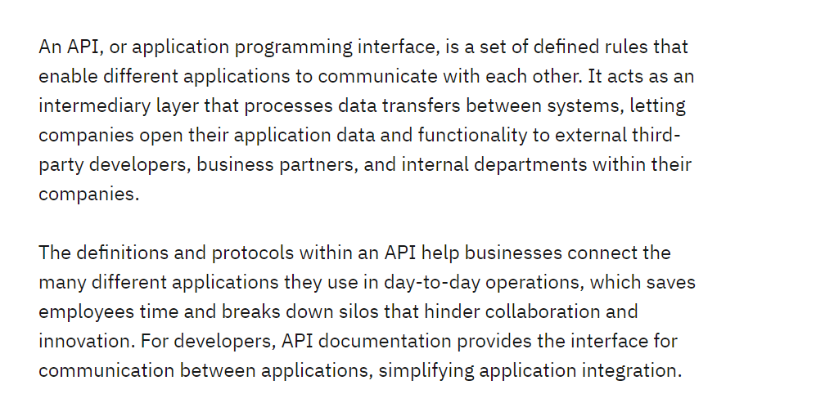
What is an API

Slide 3
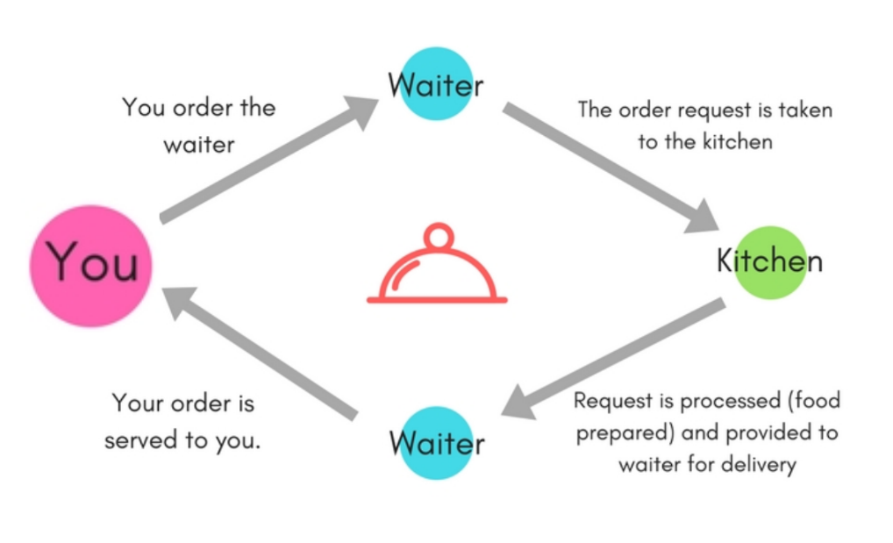
How API Actually Works

Slide 4
Why is API Testing Important
It is important because APIs are the backbone of modern applications and ensure that the different components of the application communicate with each other correctly.
It ensures that the application programming interface (API) performs as expected and fulfills user needs. Through this testing, testers can detect defects and issues in the API, such as incorrect data formats, erroneous responses, or security flaws. Seeing such problems early in the development process allows developers to address them before they become more complex and take longer to resolve.

Slide 5
What are the API Methods
Get Request
This is most common request and it is used to request data from the server
It retrieves and represents the exact data present and does not modify or perform task
Even if multiple identical requests are made, it returns the same result, this is called Idempotent
The Get request follows the read method from the CRUD operations

Slide 6
API Methods
POST Methods
It is used to send the data to the server to create or update a resource, therefore data mutation happens.
When same request is sent twice, it leads to duplication, it is called Non-Idempotent
The Post request follows the create method from the CRUD operations

Slide 7
API Methods
PUT Request
It is used to send data to the API for creating or updating an existing resource.
The difference between Put and Post is that the Put API is Idempotent.
Put will replace the resource in its entirety
Delete Request
It is used to delete a single or list of resources, more commonly found in RESTful API. It has to be used with caution.
Multiple identical requests for deleting the same resource will return a 404.

Slide 8
What is a REST API
REST (representational state transfer) is a style of software architecture that defines constraints on how different systems communicate. An API that complies with these REST principles is known as a “REST API.” The six principles of REST (five required, and one optional) are:
Client-server architecture: REST APIs separate the client (the one requesting information) from the server (the one possessing information). The client does not have to worry about how the server stores and retrieves data.
Uniform interface: Whether the client is a software application, a browser, a mobile app, or something else entirely, it can access and use the REST API in the same way.
Statelessness: The server does not have to remember the client’s state. All the client’s requests must be “stateless,” so each request must include all necessary information (such as the client’s authentication details).
Cacheability: REST servers can cache data and reuse it for other requests in the future.
Layered system: REST APIs may have multiple intermediary layers between the client and the server. However, the client does not have to know these implementation details.
Code on demand (optional): Clients may download code (e.g. Java applets or JavaScript scripts) to access additional functionality at runtime.

